Slide 1
The biology of COVID-19
KS3 – Lesson 1
Notes:
These lessons have been produced by the Institute for Research in Schools in partnership with the University of Bristol. The lessons aim to help students apply their studies to the Covid-19 pandemic, discovering important STEM career possibilities and applying mathematical principles to better understand the Covid-19 data available.

Slide 2
The biology of COVID-19
Outcomes
Know what a coronavirus is
Find out about some of the scientists who are helping us to learn more about COVID-19
Be able to explain what the R-number is
Model disease spread at different R-numbers
Be able to explain how mathematical modelling of disease spread can be useful
The Institute for
Research in Schools
2

Slide 3
Pulling together in a pandemic
INSERT PICTURE
Task:
What is a pandemic?
How can scientists help in a pandemic?
Write a list of all the roles you can think of and how they help.
A pandemic needs a co-ordinated response to help to bring it under control.
The Institute for
Research in Schools
3
Notes:
This can be discussion that is teacher-led, either in person or on an online platform, or students can do this independently, making their own notes on the lesson. Encourage students to think more deeply than frontline medical staff; the outcomes should have given hinted that the response of scientists goes a lot further than that.

Slide 4
)
Scientists who help in a pandemic include …
Frontline Medical staff
Laboratory technicians
Hospital pharmacists
Infectious disease epidemiologists
Statisticians
Computer modellers
Vaccine developers
Vaccine producers
Molecular epidemiologists
Public Health Officials
Logisticians
Mathematicians
INSERT PICTURE
A team of scientists with different skills are needed to solve a complex problem such as managing a pandemic
The Institute for
Research in Schools
4
Notes:
Students may have thought of additional scientists who help during a pandemic – there are many more. Encourage discussion about this to broaden out their assumptions about jobs in STEM.

Slide 5
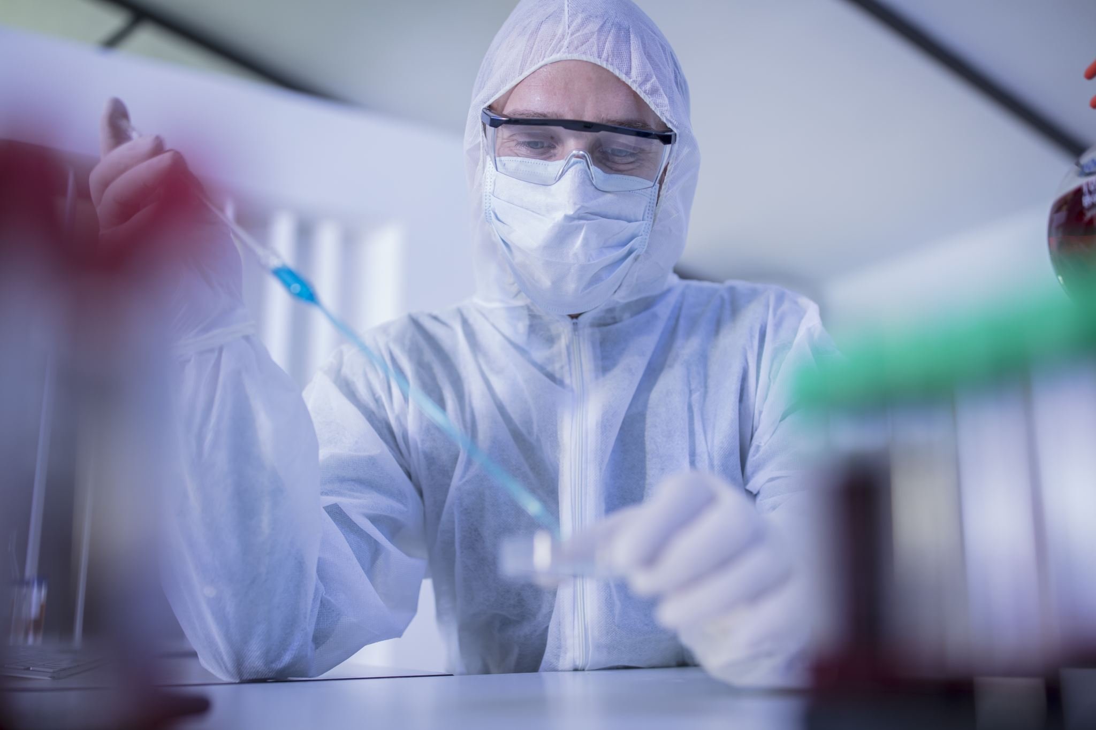
Epidemiologists study health and disease amongst people. They help to deliver public health services and respond to biological threats to the human population. There are many types – here are two:
INSERT PICTURE
INSERT PICTURE
Infectious disease epidemiologists look at the effect of the disease on the population. They can use big data and mathematical models to make predictions about how many people might be infected.
Infection control epidemiologists work to understand the disease and recommend most appropriate control measures to control the immediate spread.
The Institute for
Research in Schools
5
Notes:
Can students think of examples of how they have seen these people work in the past year? Examples include the modelling of the spread of Covid-19 that was used by Professor Chris Whitty on the televised Covid-19 updates. Infection control epidemiologists will have advised on what Personal Protective Equipment (PPE) was required to minimise the spread of the virus.

Slide 6
Insert running header (PowerPoint Title)
How do we know a new disease has arrived and is spreading?
Scenario
You are a General Practitioner (Doctor) in a village surgery in the North East of England.
One week you have six patients coming to your surgery with the same unusual combination of symptoms. They seem quite ill but it isn’t something you have seen before.
What do you do? Who do you speak to?
INSERT PICTURE
GPs are often on the front line of identifying a new illness amongst the population
The Institute for
Research in Schools
6
Notes:
Students are asked what they would do if they were a GP who had identified a new illness. They should come round to the idea that there needs to be a coordinated system of reporting such diseases (and others, known as ‘notifiable’ diseases) so that monitoring of the population can be carried out, and steps taken to identify and limit the spread of any new disease. They may already be familiar with the organisation called ‘Public Health England’ who are responsible for preparing for and responding to public health emergencies.

Slide 7
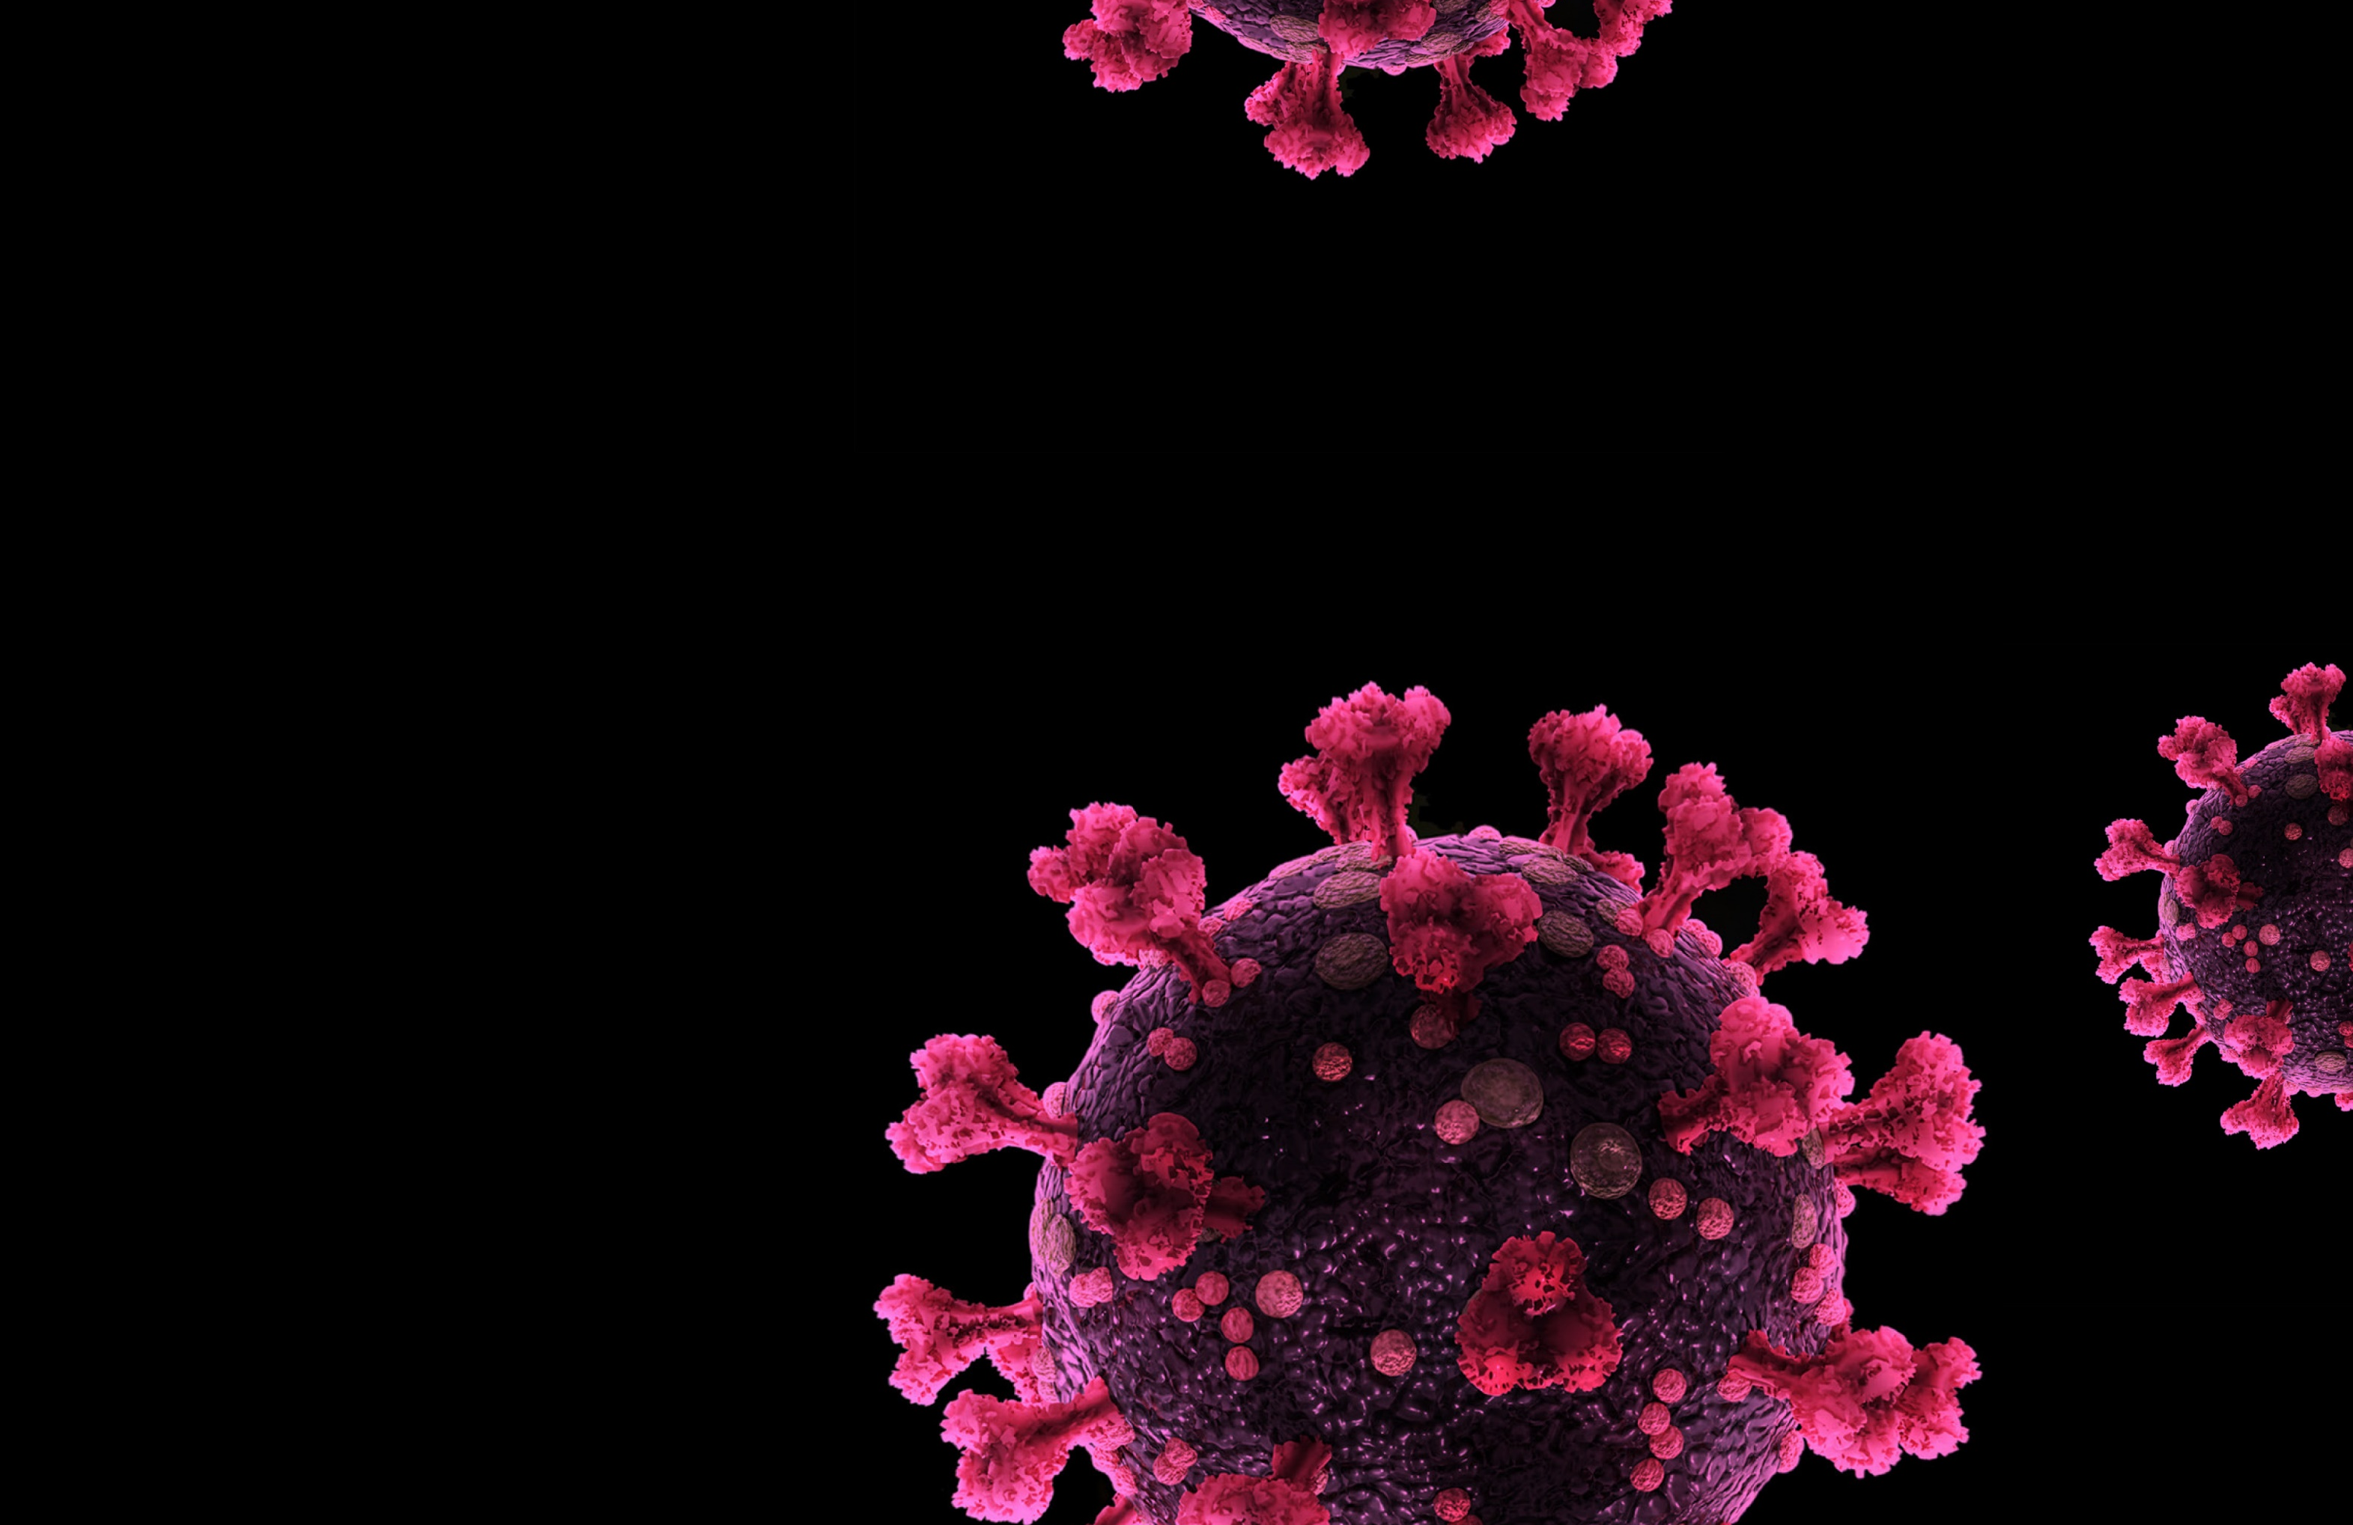
COVID-19 as a disease
COVID-19 is the disease caused by a novel (newly identified) coronavirus (SARS-CoV-2).
Coronaviruses are a family of viruses that cause illness in humans and animals.
Seven different types of coronaviruses have been found in people, including those causing the common cold, SARS, MERS and Covid-19.
INSERT PICTURE
A coronavirus such as SARS-CoV-2 that causes COVID-19 looks a bit like a crown (or corona) when viewed under a microscope.
The Institute for
Research in Schools
7
Notes:
There are three key points here – COVID-19 is the disease caused by the novel coronavirus SARS-CoV2; there are several coronaviruses already known, including the one that causes the common cold; SARS-CoV2 is new to us – we haven’t seen it before.

Slide 8
What is the R-number, and why is it important?
INSERT PICTURE
Has anyone heard of the R-number?
Do you know what it means?
Why is it important?
What things can change the R-number?
The Institute for
Research in Schools
8
Notes:
The ‘R’ number is the reproduction number of a disease. It refers to how many people an infected person passes the disease on to, on average. With an R number of 1, each person passes the disease onto one other person on average. This means that the number of cases in the population stays pretty much the same. If the R number is over 1, on average each person is spreading the disease to more than one other person, and the amount of the population who have the disease will increase. The bigger the R number, the faster the population becomes infected.
The R number is important because it gives an idea of how many people are likely to become ill over what period of time. It lets organisations like Public Health England and the Government know when it is time to take action to reduce the rates of infection.
The R-rate does not just depend on the disease, it also depends on our behaviour. The R-number can be reduced by cutting down the number of people that each person mixes with, staying further apart and washing hands. It can also be reduced if anyone infectious stays away from other people.

Slide 9
Activity
Sheet KS3.1
INSERT PICTURE
See what happens to the numbers infected with different R-numbers
The Institute for
Research in Schools
9

Slide 10
The biology of COVID-19
Outcomes
Know what a coronavirus is
Find out about some of the scientists who are helping us to learn more about COVID-19
Be able to explain what the R-number is
Model disease spread at different R-numbers
Be able to explain how mathematical modelling of disease spread can be useful
The Institute for
Research in Schools
10

